Slide 1
Machine Learning
Machine Learning Introduction to Machine Learning by Kumar Anurupam is licensed under a Creative Commons Attribution-4.0 International License.
Artificial Neural Networks – Activation Function, Learning Rules
CS 3104 Fall 2019
Lecture Slides by Kumar Anurupam

Slide 2
Learning Objectives
After completion of today’s session you will be able to:
Explain the concept of Activation Function.
Elaborate the Perceptron Learning Algorithm.

Slide 3
Perceptron
The simplest type of neural network classifiers is the perceptron, consisting of a single artificial neuron (Rosenblatt, 1957)
A perceptron is a simple classifier that takes the weighted sum of the D input feature values (along with an additional constant input value) and outputs + 1 for yes if the result of the weighted sum is greater than some threshold T and outputs 0 for no otherwise.

Slide 4
Explanation

Slide 5
Activation Function
In artificial neural networks, the activation function of a node defines the output of that node given an input or set of inputs.
It is also known as transfer function.
Activation function decides, whether a neuron should be activated or not by calculating weighted sum and further adding bias with it.
The purpose of the activation function is to introduce non-linearity into the output of a neuron.

Slide 6
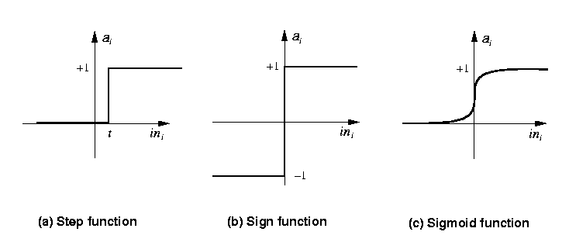
Activation Function – Contd…
The most commonly used are
Step_{t}(x) = 1 if x >= t, else 0
Sign(x) = +1 if x >= 0, else –1
Sigmoid(x) = 1/(1+e^{-x})

Slide 7
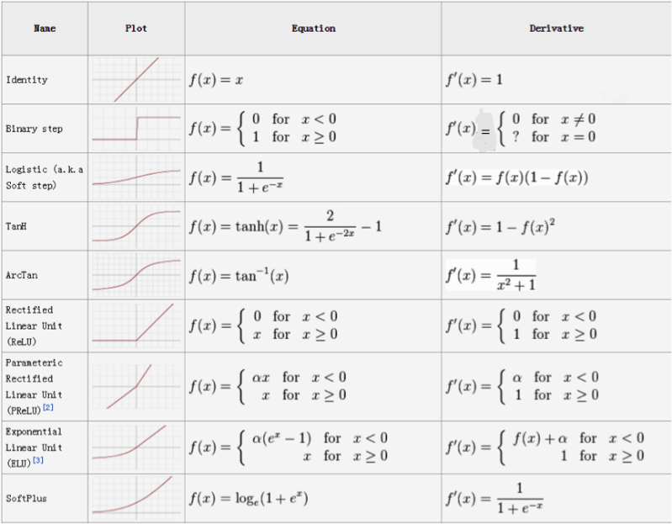
Activation Function – Contd…

Slide 8
A Supervised Learning Process
Assign random Weights
Assign random values to the weight vector
Apply the weight update rule to every training example
Are all training examples correctly classified? If Yes. Quit or Go back to Step 2.

Slide 9
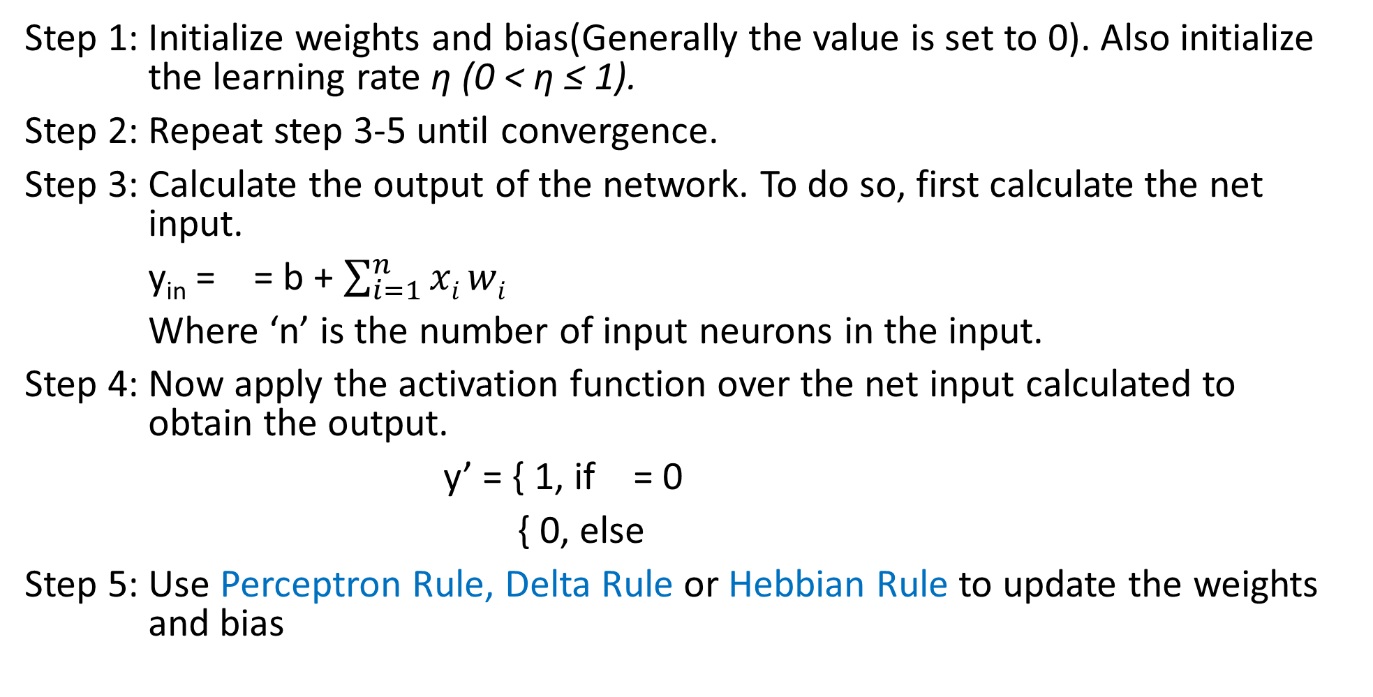
A Perceptron Learning Algorithm
Step 1: Initialize weights and bias(Generally the value is set to 0). Also initialize the learning rate η (0 < η ≤ 1).
Step 2: Repeat step 3-5 until convergence.
Step 3: Calculate the output of the network. To do so, first calculate the net input.
y_{in} = = b + $\sum_{i=1}^{n}{xi}wi$
Where ‘n’ is the number of input neurons in the input.
Step 4: Now apply the activation function over the net input calculated to obtain the output.
y’ = { 1, if = 0
{ 0, else
Step 5: Use Perceptron Rule, Delta Rule or Hebbian Rule to update the weights and bias

Slide 10
Rules of learning in a Perceptron
The Perceptron Rule:
Update each weight according to this rule:
w_{i} = w_{i} + Δw_{i}
Where:
Δw_{i} = η (t-o) x_{i}
t: target output
o: output generated by the perceptron
η: constant called the learning rate (e.g., 0.1)
Provided the examples are linearly separable and a small value for η is used,
The rule is proved to classify all training examples correctly

Slide 11
Example

Slide 12
References
[1] https://en.wikipedia.org/wiki/Activation_function
[2] https://www.geeksforgeeks.org/activation-functions-neural-networks/

Slide 13
Thanks

